Slide 1






SERCOM-2 Side Event:
WMO best kept secret - Associated Programme on Flood Management (APFM) 20 years and continuing
VFDM project summary
18 October 2022

Slide 2
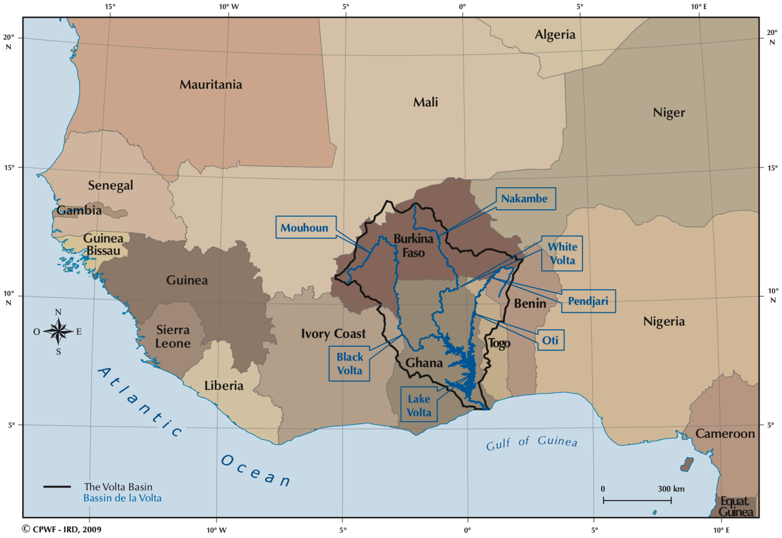
VFDM: Integrating Flood and Drought Management and Early Warning for Climate Change Adaptation in the Volta Basin
Benin, Burkina Faso, Côte d’Ivoire, Ghana, Mali and Togo
Donor: Adaptation Fund
Funding Amount: 7,920,000 USD
Project Timeframe: 26 June 2019- 25 June 2023
(request for one year no-cost extension)
Project Executing Partners:
World Meteorological Organization (WMO)
Global Water Partnership West Africa (GWP-WAF)
Volta Basin Authority (VBA)
Supported by: National Agencies of the six countries and international organizations
Project Objective:
to provide the first large scale and transboundary implementation of Integrated Flood and Drought Management by empowering the National Meteorological and Hydrological Services (NMHS) and other competent authorities.

Slide 3
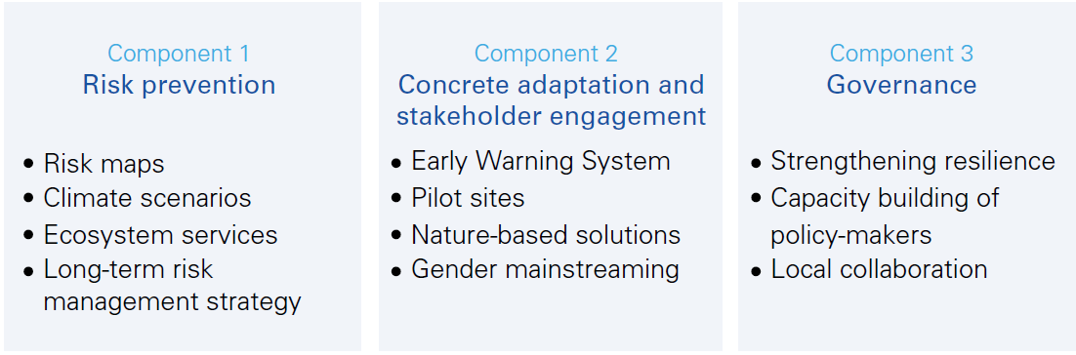
VFDM Project components
  Project concept note and proposal : click here

Slide 4
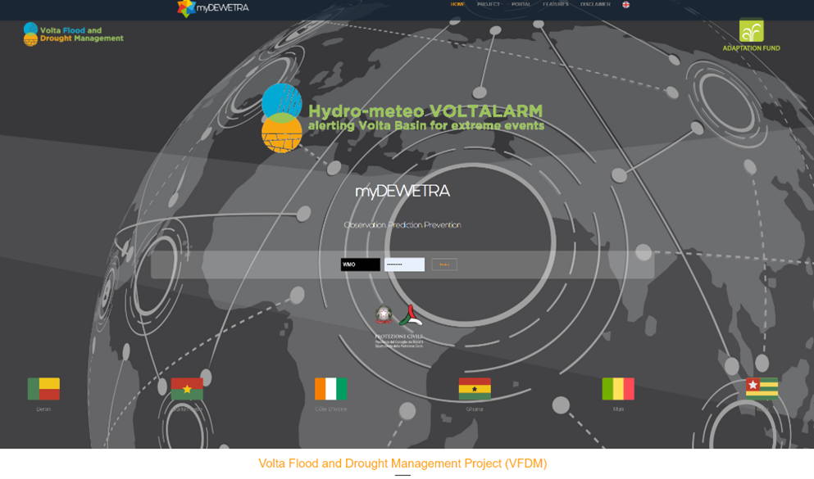
VOLTALARM EWS
Configuration of cloud-based myDewetra System – DCP Server and managed by CIMA
( having global products and information)
https://volta.mydewetra.world/

Slide 5
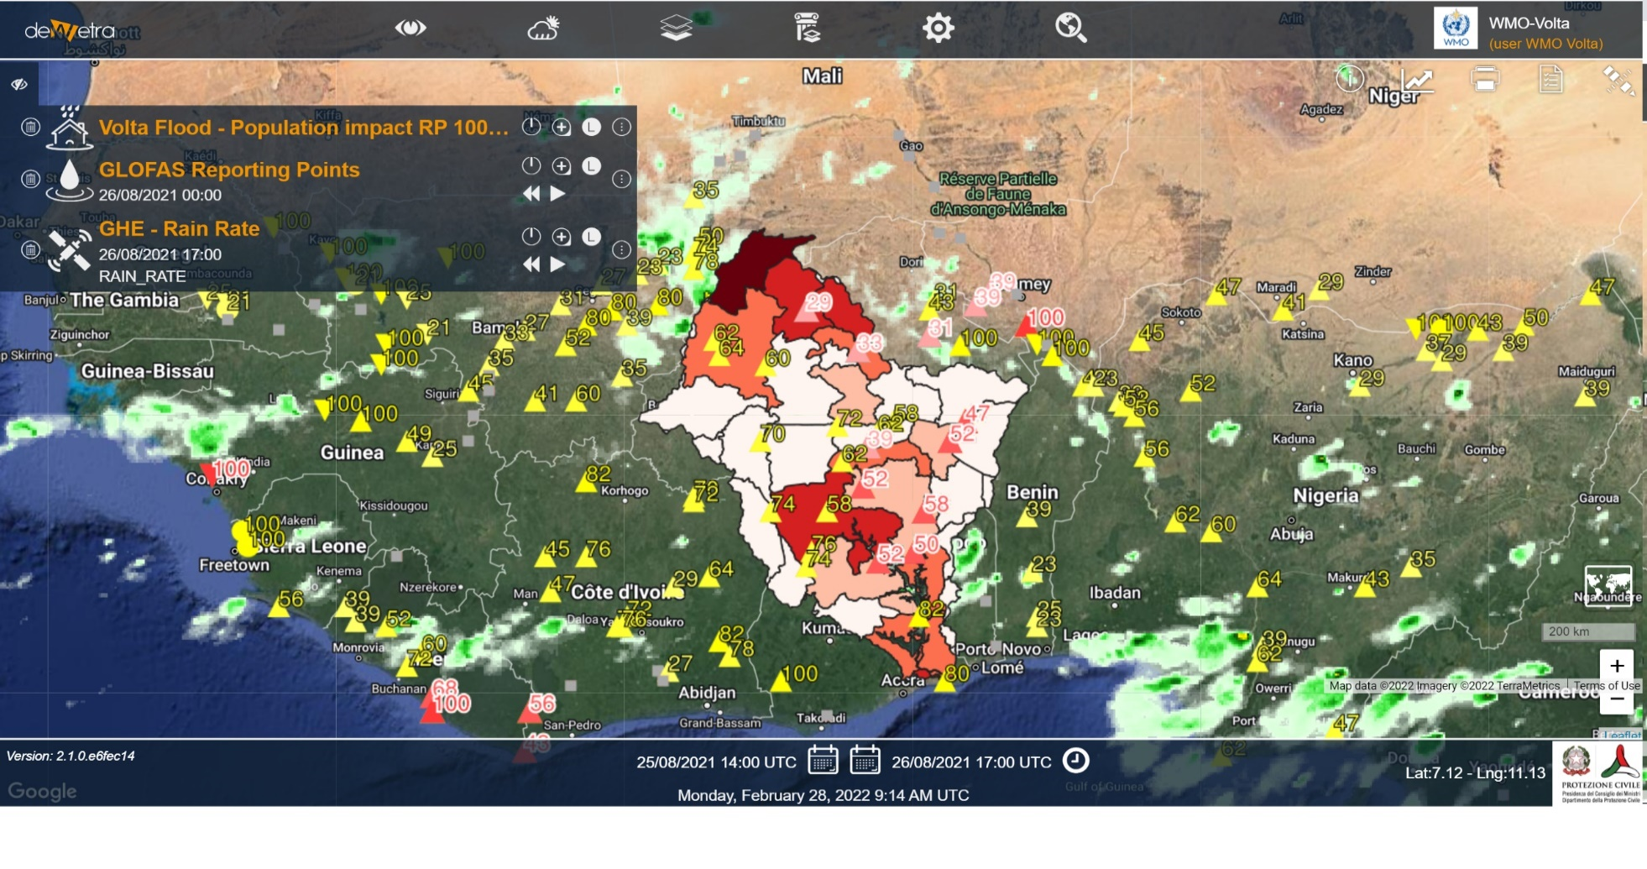
VOLTALARM EWS
Risk Maps and Climate Scenarios are visualized
July 2022- Provided hybrid training to the National and Regional stakeholders of the Volta Basin for the usage in their day-to-day services

Slide 6
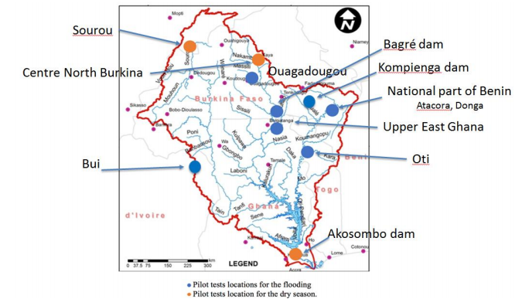
Next activities (continuation and new) of the project in 2022 and 2023
Installation of the National Centralized database in the Six Volta Basin countries– July 2022 onwards
Maintain the cloud-based VOLTALARM system and explore the possibility of storing the data in a server based at the VBA
Development of Hydro-Meteo models and forecasting system for the Volta Basin
Testing of VOLTALARM EWS in the 10 selected pilot sites to understand the applicability and effectiveness of the VoltAlarm

Slide 7
Encountered Challenges
The onset of the Covid 19 pandemic with travel restrictions for Project partners;
Real-time data sharing from the National agencies to the Regional Authorities
Linkage and connection of various activities/sub-activities with other on-going projects or initiatives in the Volta Basin countries

Slide 8
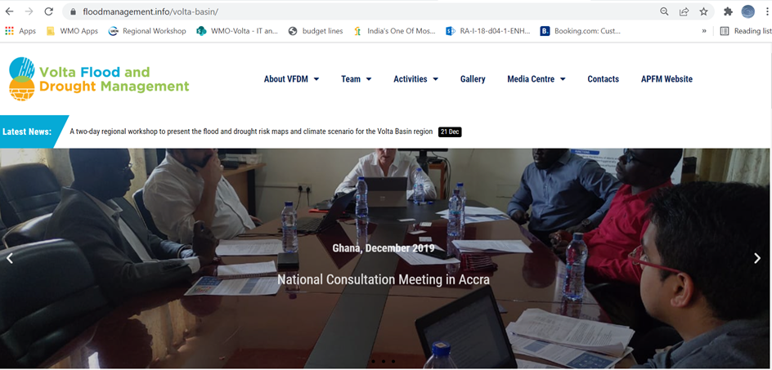
VFDM Project website
https://www.floodmanagement.info/volta-basin/

Slide 9
For more info: visit VFDM project website https://www.floodmanagement/volta-basin
thank you for
your kind attention

